Slide 1
Integration platform development
David Bohmann
14.11.2018

Slide 2
Customer’s project assignment
Microsoft Dynamix AX (Axapta)
Enterprise resource planning (ERP) tool
Etnetera a. s.
New e-shop development
Existing middle-ware
JBoss + custom implementation
Our tasks
- Create new middle-ware that takes into account changes in AX
API and new e-shop

Slide 3
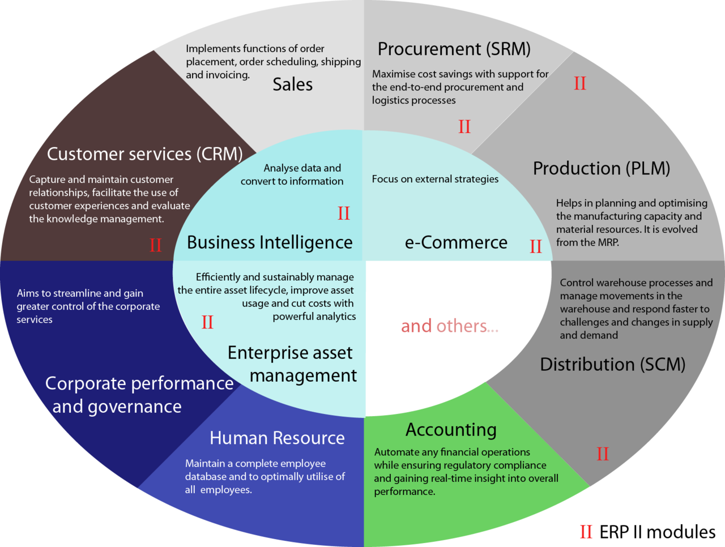
ERP modules

Slide 4
Our tasks
Why?
Completely new e-shop
Changes in AX API
Changes in data flows
What?
Implementation of middle-ware between e-shop and AX
Creation of monitoring console to monitor data flows
Our choice of technology

Slide 5
Middle-ware
Apache Camel
Java framework focused on easier integration
Concrete implementation of used EIP (Enterprise Integration Patterns
Connects to wide spectrum of transports (facebook, Github, …)
Easy use of DSL (Domain Specific Language)
Definition of data flows
BeanBinding: defines which methods are invoked and how the message is converted into the parameters of the methods.
WSDL (Web Services Description Language)
Processor: Custom definition of conversion of the message

Slide 6
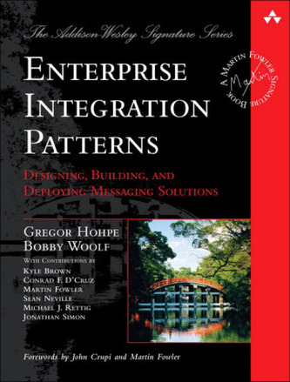
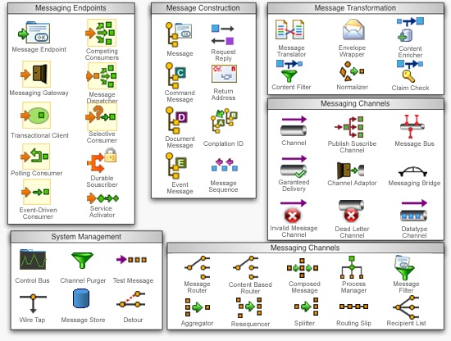
Enterprise Integration Patterns

Slide 7





Enterprise Integration Patterns
Message channel
Basic communication of two apps
Message Router
Sends message from app to chosen other app
Message Translator
Conversion from input message format to output message format
Dead Letter Channel
Treatment of undelivered message
Guaranteed Delivery
Confirmation about successful delivery of message

Slide 8

Enterprise Integration Patterns
Message Bus
Communication of more apps without effecting others
Request Reply
Specifies where the delivery subsystem responds
Correlation Identifier
How to assign response to concrete message
Event Message
Describes the sending of messages between subsystems
Content Based Router
Route message based on the content of the message

Slide 9
Enterprise Integration Patterns
Splitter
Splits input message to parts
Aggregator
Aggregates output message from parts to one
Content Enricher
Adding data to message, that it doesn’t contain by default
Content Filter
Removing some unneeded data from message
Log
Logging information about processing the message

Slide 10
Middle-ware
ActiveMQ
Saving and routing of messages among queues
DeadQueue – if the sending of message fails, can be repeated
Karaf
Enables deploy of plugins or custom apps (monitoring console)
JMX
Enables access to MBeans
Monitoring console recieves data from server via Jolokia library
Freemarker
template language
Parses XML and fills exctracted values to predefined template

Slide 11
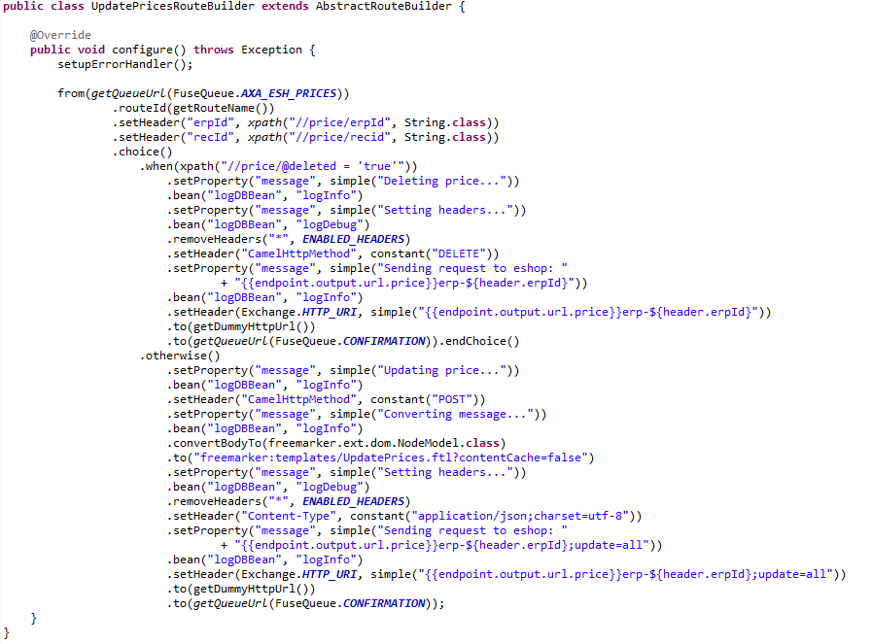
Middle-ware – definition of data flow in Java

Slide 12
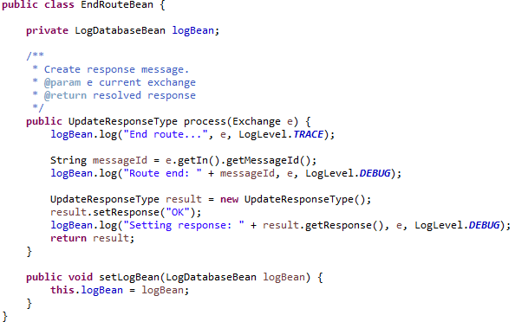
Middle-ware – custom Processor

Slide 13
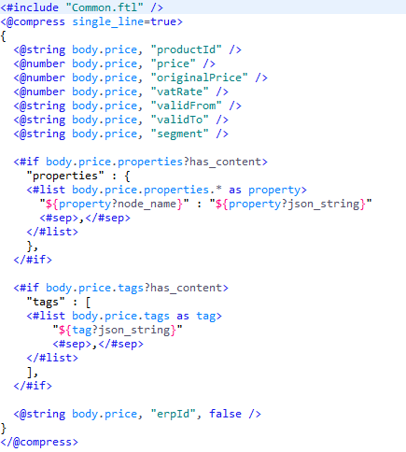
Middle-ware – Freemarker conversion
Conversion JSON / XML
From XML to JSON via predefined freemarker templates
From JSON to XML via XStream library

Slide 14
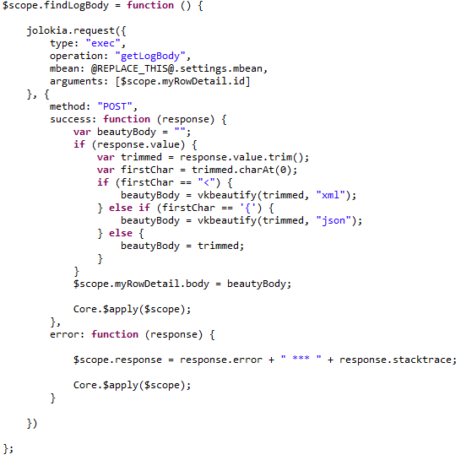
Monitoring console – Jolokia access
Logging to database
In every data flow and processor
JDBC connection to MySQL
Monitoring console
View of logs in database
Filter and advanced search
Access via Jolokia library

Slide 15
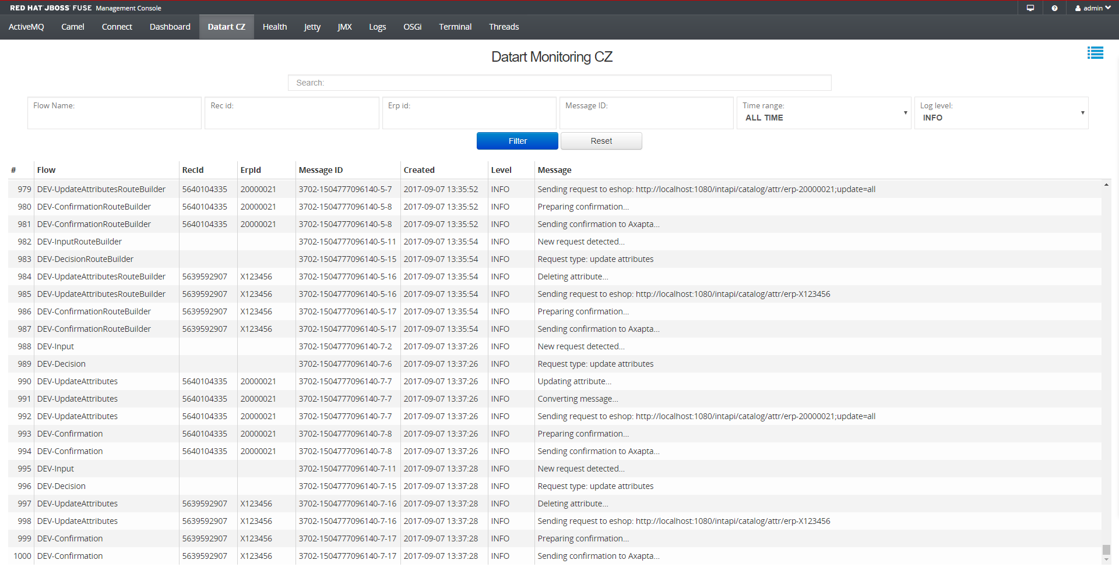
Monitoring console

Slide 16
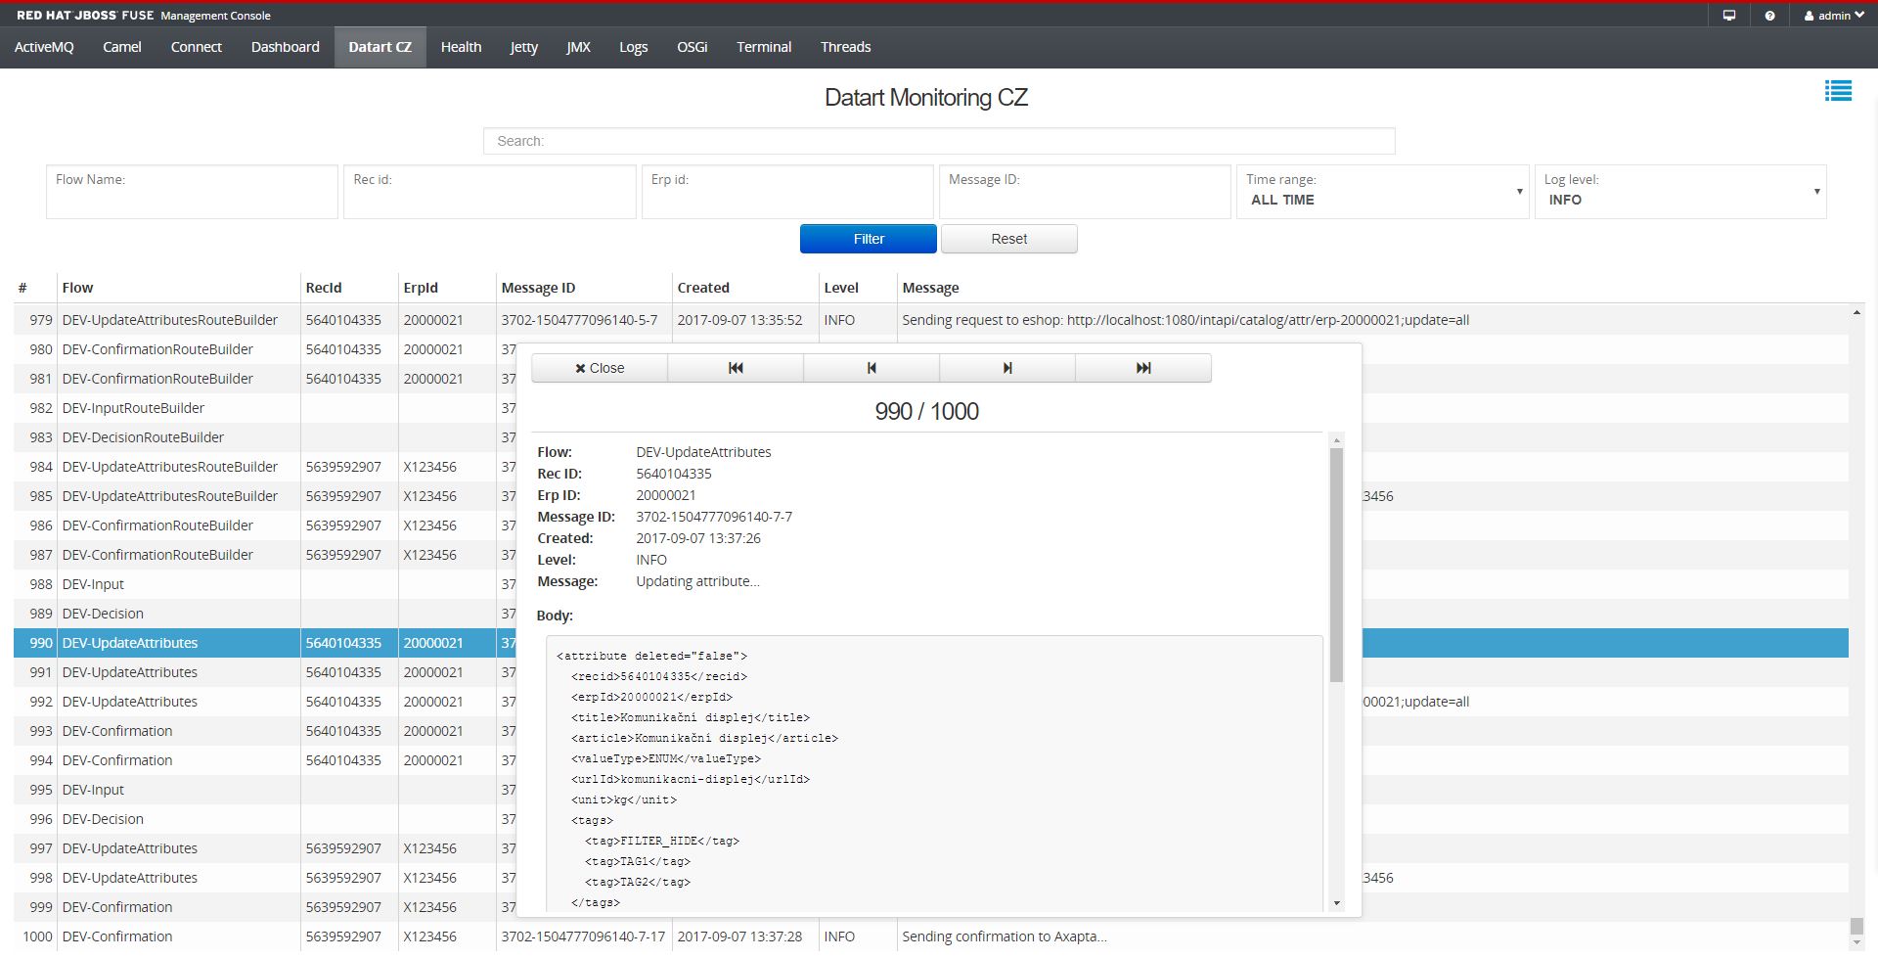
Monitoring console

Slide 17
List of used technologies
XML,HTTP,WSDL,SOAP,REST,JSON
Camel, ActiveMQ, Karaf, JMX
MySQL
Javascript, Angular, HTML5, CCS3
Freemarker
Synchronous/asynchronous message delivery
After e-shop request wait for AX, after AX response send confirmation and message to e-shop
After AX request respond 200-OK immediatelly, after parsing of message send message to e-shop

Slide 18
Testing
Integration tests
testing, if message and confirmation are sent and received correctly
SoapUI + mockserver: imitation of e-shop and AX
Performance tests
JMeter for simpler tests without need of mockserver
Creation of simple server (only responds 200-OK) and script that measures performance and queues via JMX

Slide 19

Thank you for your attention!

